Slide 1

SOCIAL ISSUES AND
THE ENVIRONMENT
SUBHASHRI S
(2019105586)
EVS – GE5251
B.E. ECE

Slide 2
INTRODUCTION
We live in the natural as well as the social world.
Development cannot be of only the rich nor it means only high living standards.
Also not just ECONOMIC development.
It has to be a holistic approach, where it brings benefits to both present and future generations.

Slide 3
DOES DEVELOPMENT LEAD TO ENVIRONMENTAL PROBLEMS?
YES.
Social aspects, development and environment have a strong relation.
Development aims at improving global economy and standard of living yet leads to environmental degradation.
Major factor is Unsustainable Resource Use And Unsustainable Growth Practices.

Slide 4
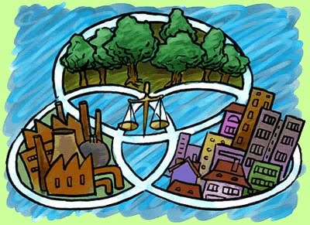
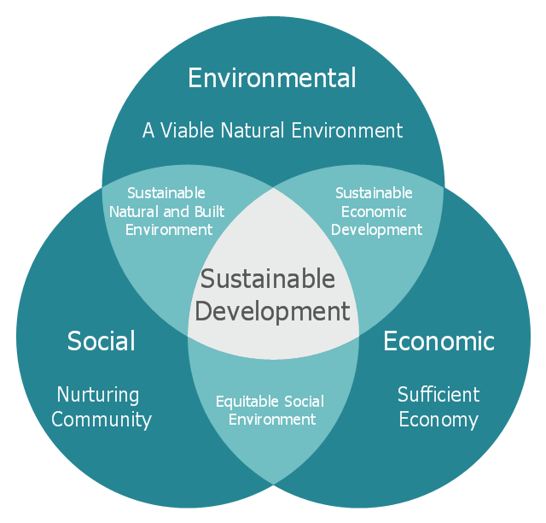
FROM UNSUSTAINABLE TO SUSTAINABLE DEVELOPMENT..
G.H Brundtland, (Norwegian Prime Minister and Director of World Health Organization) gave the definition for sustainable development.
Sustainable development is defined as
“meeting the needs of the present without compromising the ability of future generations to meet their own needs.”

Slide 5
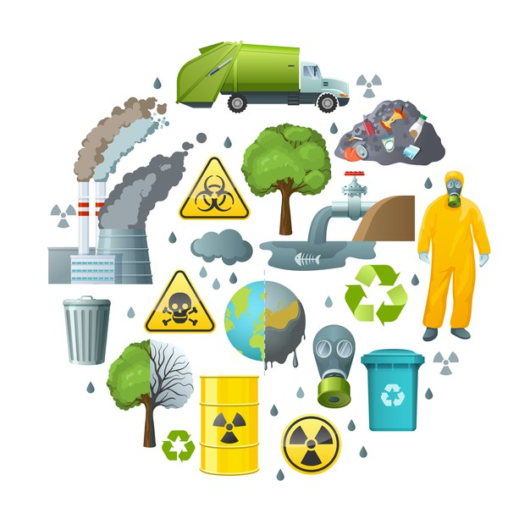

Slide 6

Few parameters for achieving sustainable growth:
Eradicate poverty and hunger, guaranteeing a healthy life.
Universalize access to basic services such as water, sanitation and sustainable energy.
Care for the environment combating climate change and protecting the oceans and land ecosystems.
Prevention of social erosion and the protection of our biodiversity.
Increment of the forest cover and to cut off the emissions of CFC, SOx, NOx and CO2.
Reduction of waste generation.

Slide 7
CURRENT SCENARIO
Until now development has been human oriented.
We have touched greatest heights of scientific and technological developments.
At WHAT COST??
Due to over exploitation, our natural resources are dwindling.
We will be facing a “doom’s day” – as suggested by Meadows et al (1972) in their world famous academic report “The Limits to Growth”.
This is unsustainable development which will lead to a collapse of the interrelated systems of this earth.
A clear discussion on sustainable development emerged on an international level in 1992, in the UN Conference on Environment and Development (UNCED), popularly known as The Earth Summit, held at Rio de Janeiro, Brazil.
The Rio Declaration aims at a new and equitable global partnership through the creation of new levels of cooperation among states.
Agenda-21 proposes a global programme of action on sustainable development in social, economic and political context for the 21st Century.

Slide 8


Slide 9
KEY ASPECTS OF SUSTAINABLE DEVELOPMENT:
INTER – GENERATIONAL EQUITY:
Reduction of impacts on resources and environment for future generations.
Hand over a safe, healthy and resourceful environment to our future generations.
Stop over-exploitation of resources.
Reduction in waste discharge and emissions.
Maintain ecological balance.

Slide 10
INTRA – GENERATIONAL EOUITY:
Minimize the wealth gaps within and between nations.
The Human Development Report of United Nations (2001) emphasizes that the benefits of technology should seek to achieve the goals of intra-generational equity.
Technology should address to the problems of the developing countries.
Production of drought tolerant varieties for uncertain climates, vaccines for infectious diseases, clean fuels for domestic and industrial use.
This will support the economic growth of the poor countries and help in narrowing the wealth gap and lead to sustainability.

Slide 11
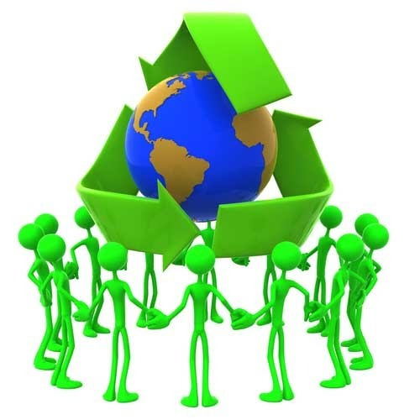

Slide 12
THANK YOU!!

